Slide 1
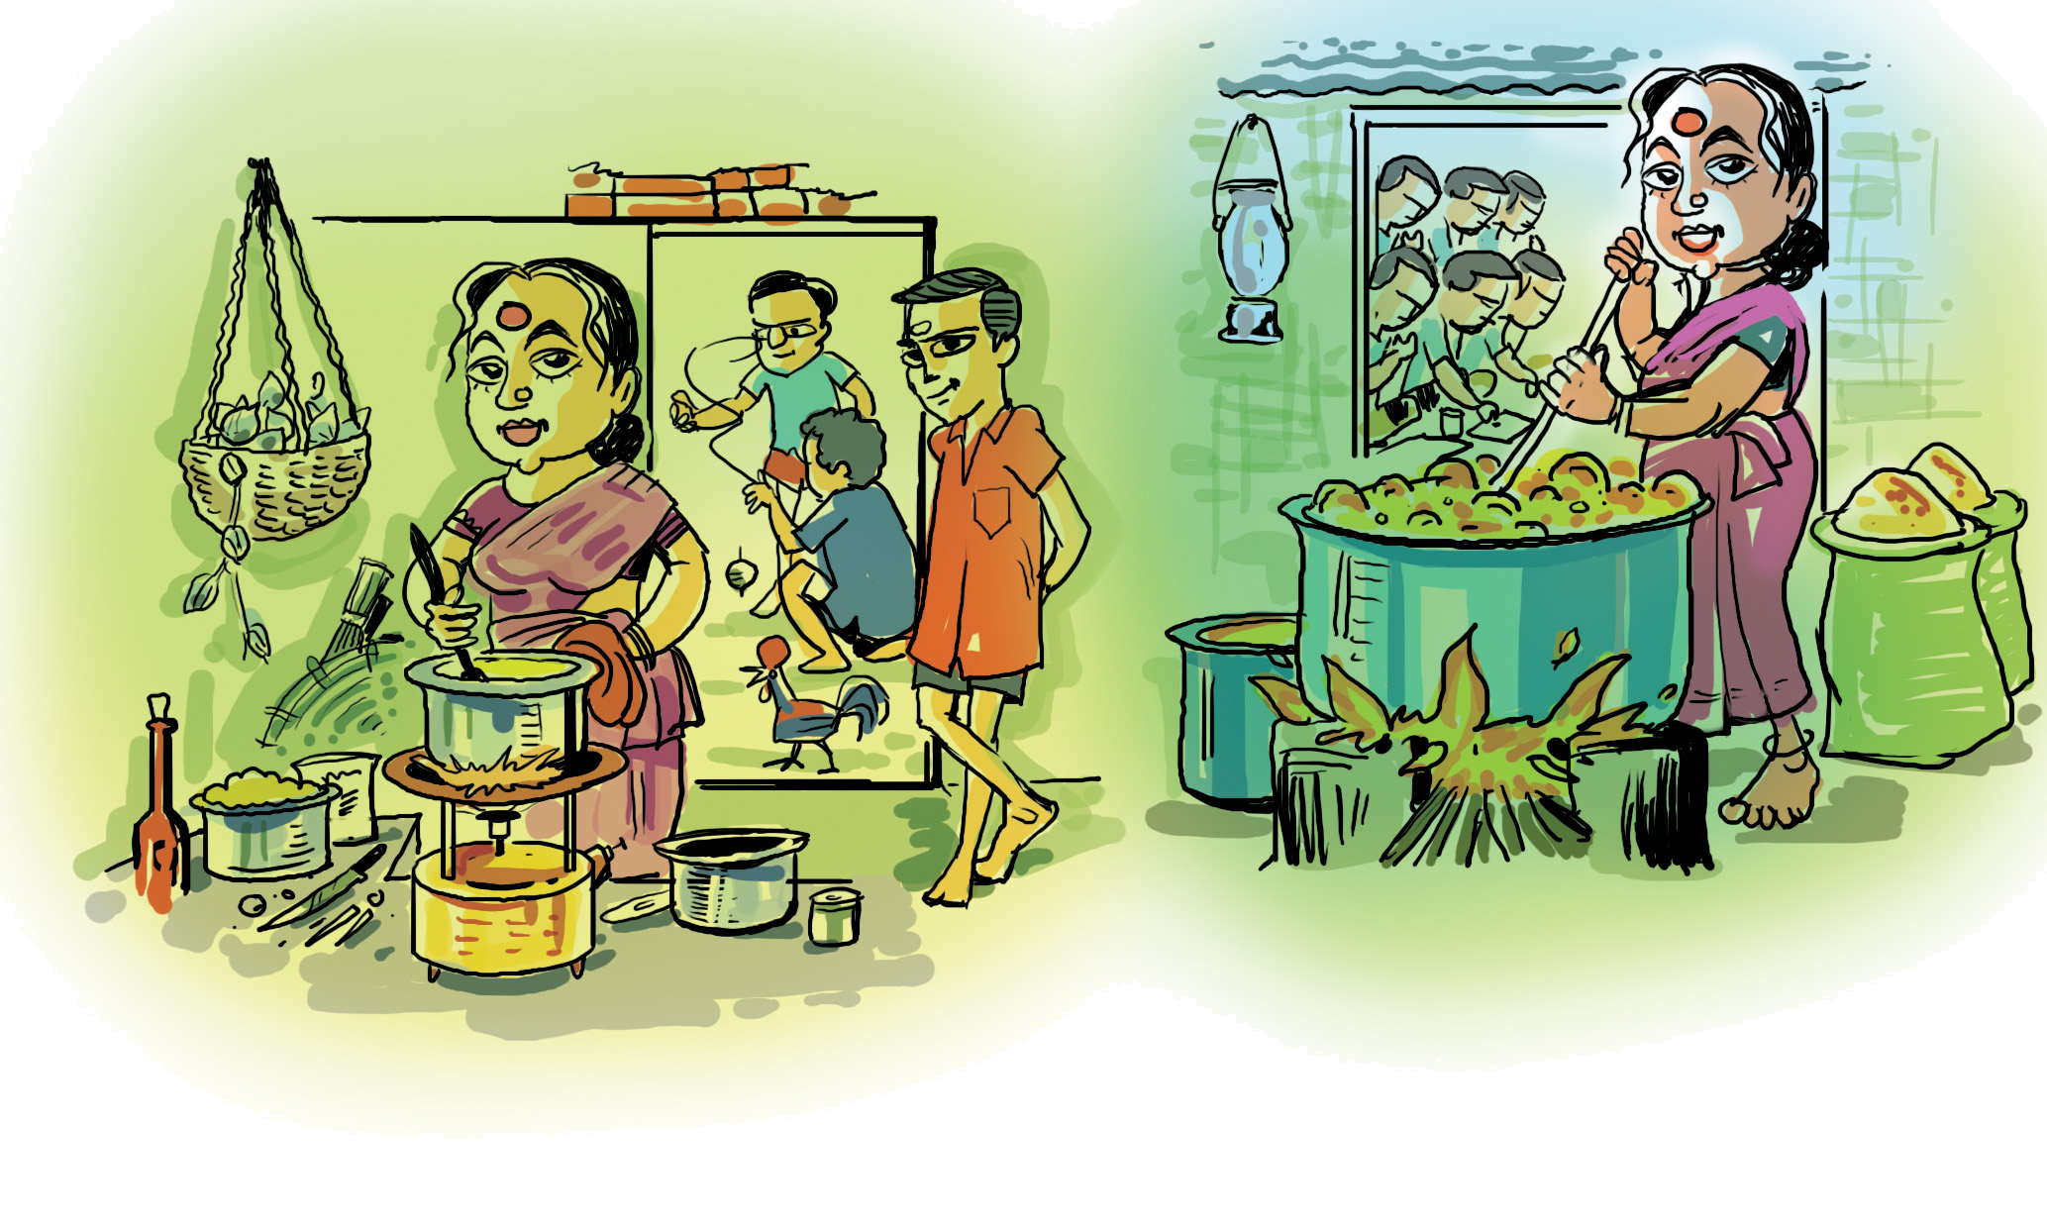
State what you See

Slide 2
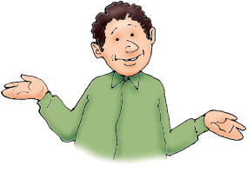
Speaking - A Responsibility
We will be able to speak better if we
  have good knowledge of the subject
  are comfortable with the language
  know the right vocabulary and terms
  are comfortable with the audience
  can overcome our nervousness or shyness

Slide 3
These are SKILLS and can be LEARNT

